Slide 1

M.Sc. Project Presentation
Design of Soleil Babinet Compensator
Under the supervision of
Dr V. Narayanan
Submitted By:- Prashant Kumar Barnwal
Roll no. M21PH206
Dept of Physics, IIT-Jodhpur
Date:- 03-05-2023

Slide 2
Outline
Introduction
Mueller matrix formalism
Specification and Operation
Generalized Mueller matrix for different crystals
And waveplates
Conclusion
Dual Rotating Polarimeter

Slide 3
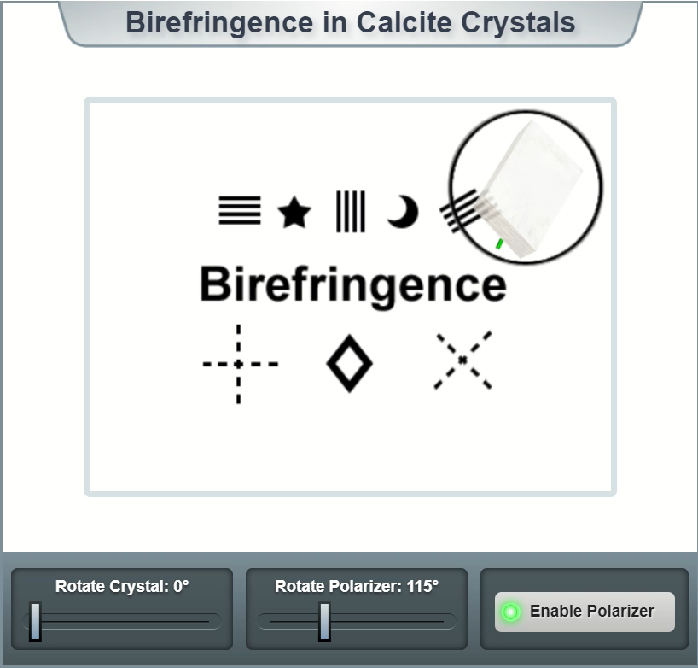
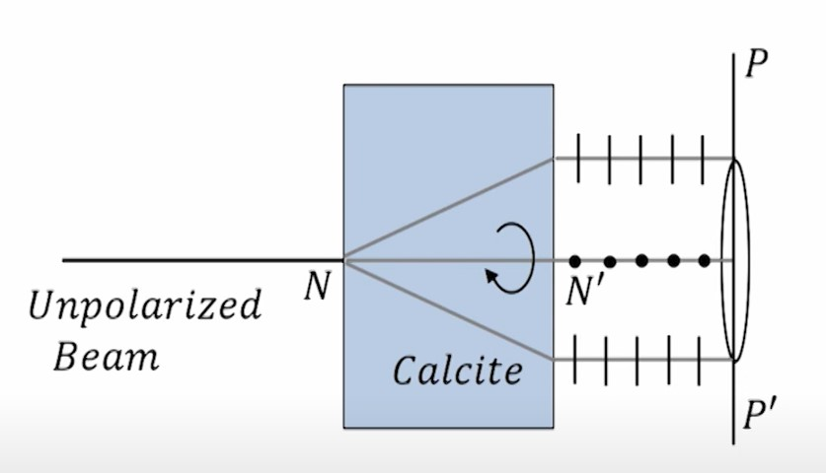
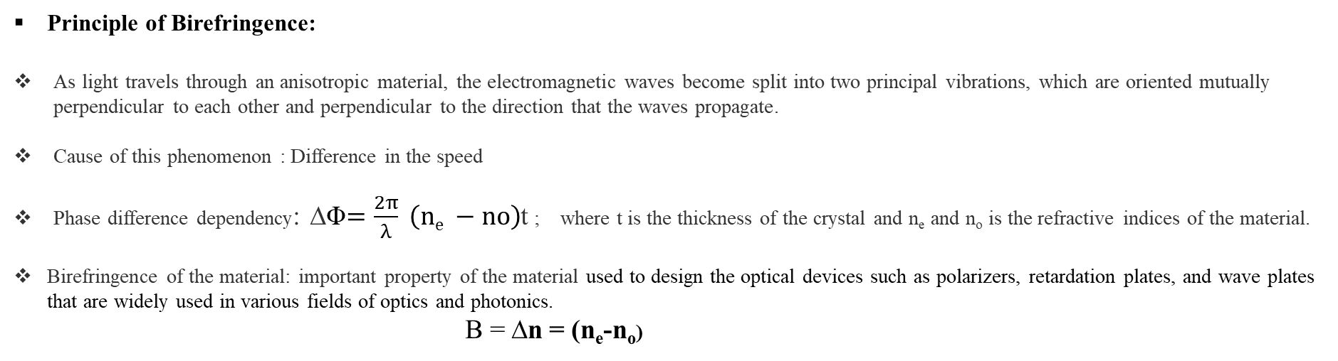
Introduction
Principle of Birefringence:
As light travels through an anisotropic material, the electromagnetic waves become split into two principal vibrations, which are oriented mutually perpendicular to each other and perpendicular to the direction that the waves propagate.
Cause of this phenomenon : Difference in the speed
Phase difference dependency: ∆Φ$=\frac{2π}{λ} \left(ne −no\right)$t ; where t is the thickness of the crystal and n_{e} and n_{o} is the refractive indices of the material.
Birefringence of the material: important property of the material used to design the optical devices such as polarizers, retardation plates, and wave plates that are widely used in various fields of optics and photonics.
B = ∆n = (n_{e}-n_{o})
E-ray
O-ray
Refrences: http://www.microscopy-uk.org.uk/mag/artmay04/dwcyc6.html

Slide 4
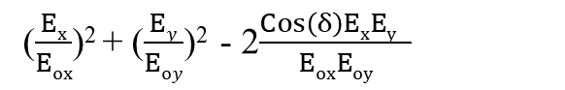
Mathematical formulation of the Polarization
The polarization ellipse is a way to visualize the polarization state.
Linear and circular polarization states are actually special cases of elliptic polarization states.
An elliptic polarization state can always be decomposed into two mutually orthogonal components.
The relative phase shift between these two components can be anywhere between -π and π.
($\frac{Ex}{Eox}$)² + ($\frac{Ey}{Eoy}$)² - 2$\frac{Cos\left(δ\right)ExEy }{EoxEoy}$
= Sin²(δ)

Slide 5
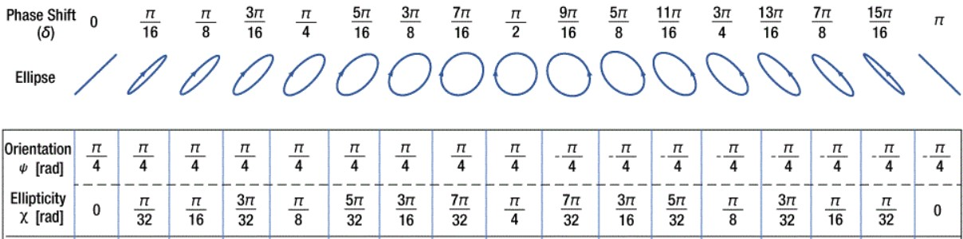
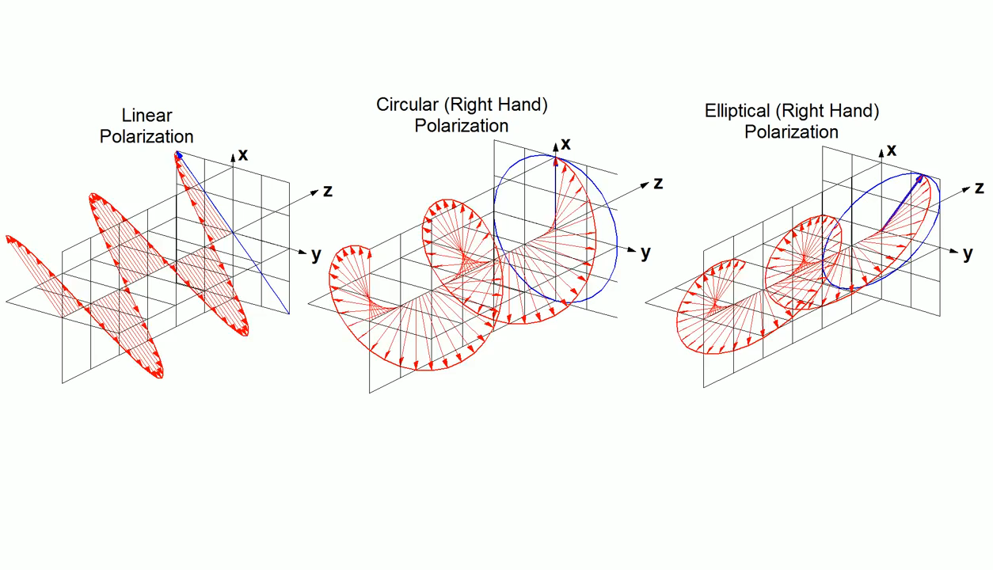
Refrences: https://gfycat.com/dazzlingfirsthandblackrhino

Slide 6
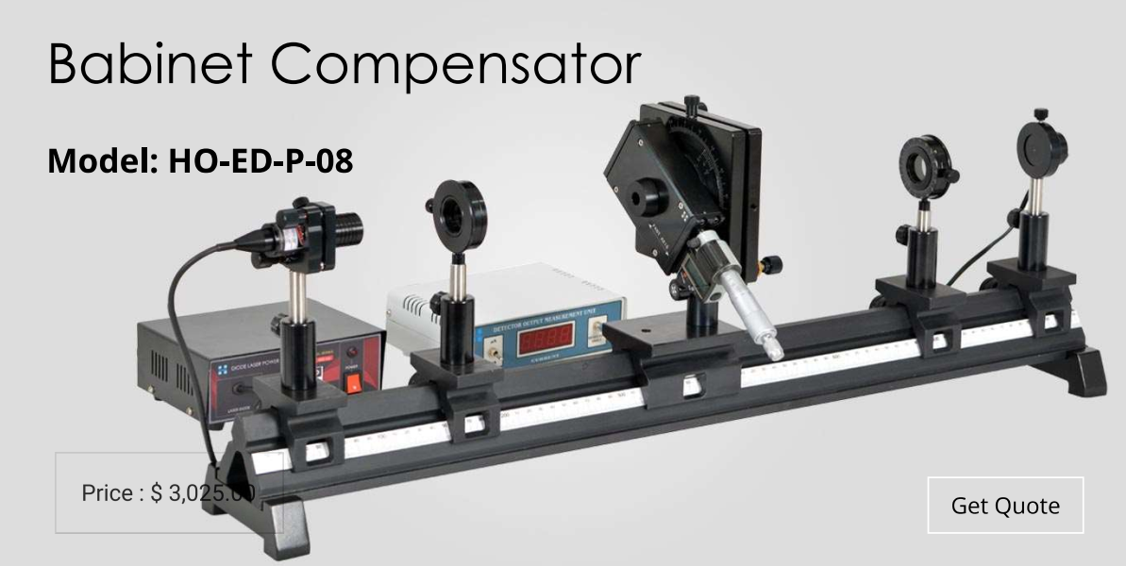
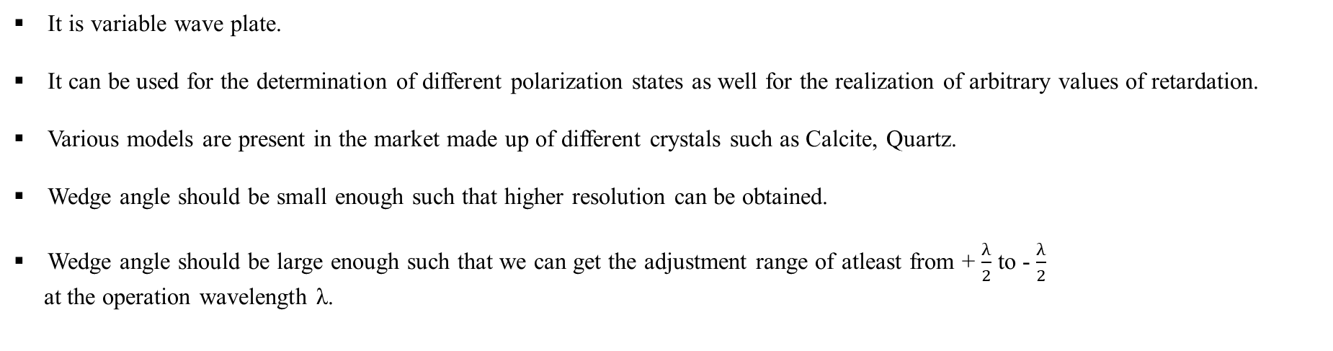
Soleil Babinet Compensator
It is variable wave plate.
It can be used for the determination of different polarization states as well for the realization of arbitrary values of retardation.
Various models are present in the market made up of different crystals such as Calcite, Quartz.
Wedge angle should be small enough such that higher resolution can be obtained.
Wedge angle should be large enough such that we can get the adjustment range of atleast from + $\frac{λ}{2}$ to - $\frac{λ}{2}$
at the operation wavelength λ.
Reference: https://www.holmarc.com/babinet_compensator.php

Slide 7
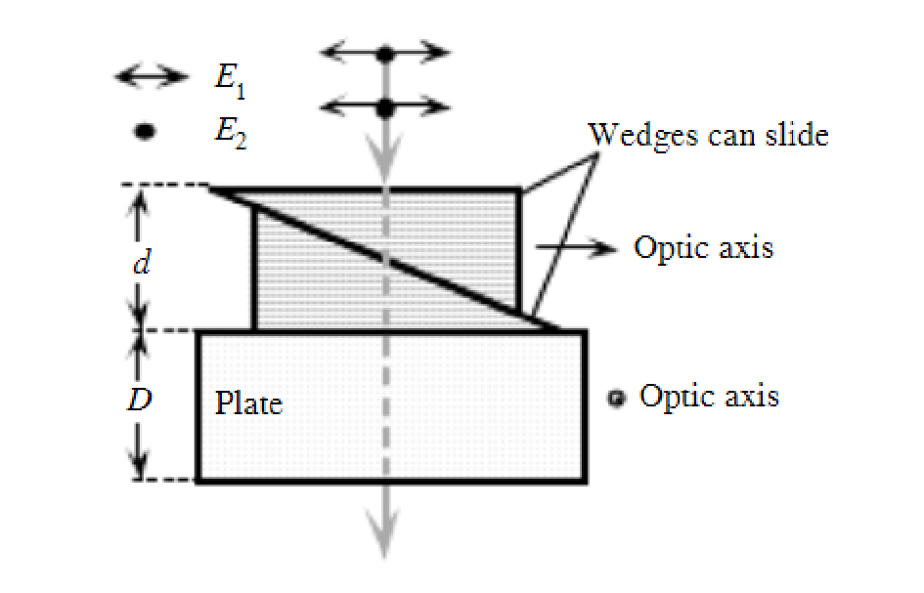
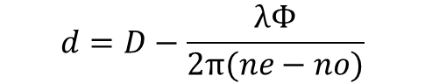
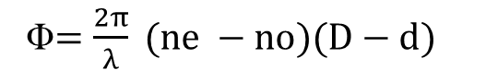

Working principle
The compensators are comprising a movable long wedge as well as a short wedge and compensation plate which are mounted with fixed position.
Φ$=\frac{2π}{λ} (ne −no)(D−d)$
$$d=D−\frac{λΦ}{2π(ne−no)}$$
$$∆d=\frac{λ∆Φ}{2π(ne−no)}$$

Slide 8
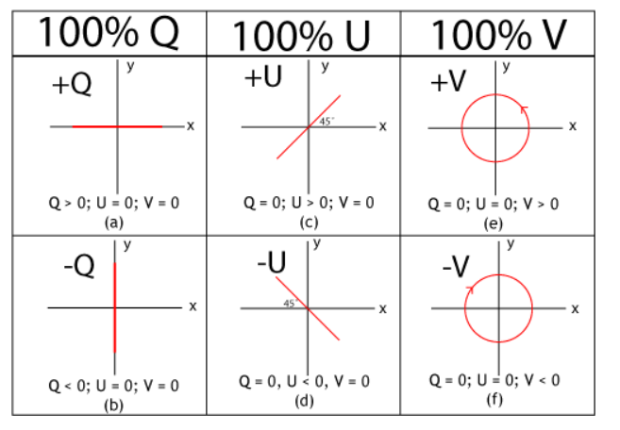
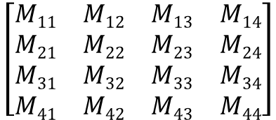
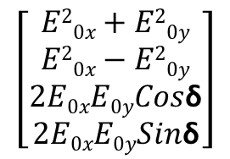
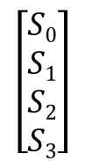
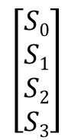
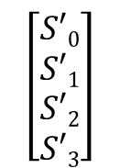
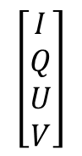
Stokes vectors and Mueller matrix formalism of the Polarization
Mueller matrices are [4x4] matrices that describe the linear relationship between polarization states of the incident light beam and the emerging light beam after passing through some polarizing elements, i.e., polarizers, waveplates, rotators.
The [4x1] Stokes vector is a four-element vector used to describe the polarization state of a beam of light.
$$\left[\begin{matrix}S0 \\ S1 \\ S2 \\ S3\end{matrix}\right]$$
$$\left[\begin{matrix}E20x+E20y \\ E20x−E20y \\ 2E0xE0yCos\text{δ} \\ 2E0xE0ySin\text{δ}\end{matrix}\right]$$
$$\left[\begin{matrix}I \\ Q \\ U \\ V\end{matrix}\right]$$
Mueller matrices are used together with stokes parameter or vectors.
They are linearly related with each other; [S’] = [M_{ij}][S]
=
=
$$\left[\begin{matrix}S′0 \\ S′1 \\ S′2 \\ S′3\end{matrix}\right]$$
$$\left[\begin{matrix}M11 & M12 & M13 & M14 \\ M21 & M22 & M23 & M24 \\ M31 & M32 & M33 & M34 \\ M41 & M42 & M43 & M44\end{matrix}\right]$$
$$\left[\begin{matrix}S0 \\ S1 \\ S2 \\ S3\end{matrix}\right]$$
=
https://en.wikipedia.org/wiki/Stokes_parameters

Slide 9
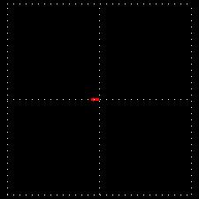
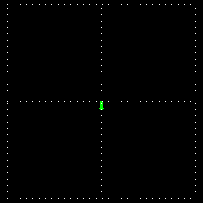
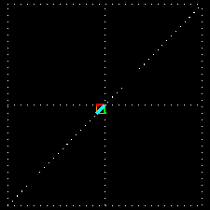
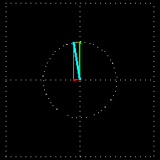
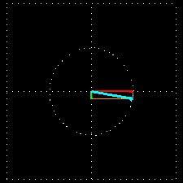
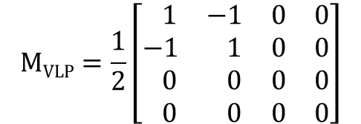
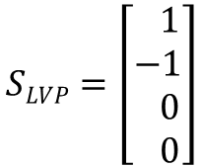
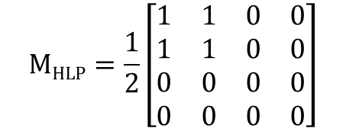
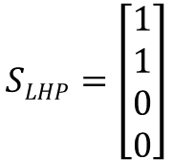
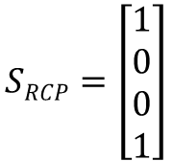
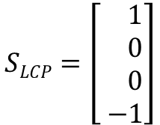
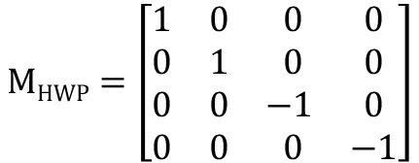
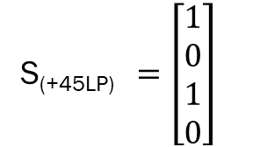
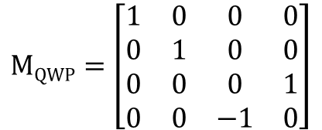
Stokes vector and Mueller matrix for various known Quantities
Following are the stokes vector of the degenerate polarization state
$$SLHP=\left[\begin{matrix}1 \\ 1 \\ 0 \\ 0\end{matrix}\right]$$
$$SLVP=\left[\begin{matrix} 1 \\ −1 \\ 0 \\ 0\end{matrix}\right]$$
S_{(+45LP)}$=\left[\begin{matrix}1 \\ 0 \\ 1 \\ 0\end{matrix}\right]$
$$SRCP=\left[\begin{matrix}1 \\ 0 \\ 0 \\ 1\end{matrix}\right]$$
$$SLCP=\left[\begin{matrix} 1 \\ 0 \\ 0 \\ −1\end{matrix}\right]$$
Following are the Mueller matrix of the known optical element
$$MHLP=\frac{1}{2}\left[\begin{matrix}1 & 1 & 0 & 0 \\ 1 & 1 & 0 & 0 \\ 0 & 0 & 0 & 0 \\ 0 & 0 & 0 & 0\end{matrix}\right]$$
$$MVLP=\frac{1}{2}\left[\begin{matrix} 1 & −1 & 0 & 0 \\ −1 & 1 & 0 & 0 \\ 0 & 0 & 0 & 0 \\ 0 & 0 & 0 & 0\end{matrix}\right]$$
$$MQWP=\left[\begin{matrix}1 & 0 & 0 & 0 \\ 0 & 1 & 0 & 0 \\ 0 & 0 & 0 & 1 \\ 0 & 0 & −1 & 0\end{matrix}\right]$$
$$MHWP=\left[\begin{matrix}1 & 0 & 0 & 0 \\ 0 & 1 & 0 & 0 \\ 0 & 0 & −1 & 0 \\ 0 & 0 & 0 & −1\end{matrix}\right]$$
Refrences: https://www.fiberoptics4sale.com/blogs/wave-optics/104730310-mueller-matrices-for-polarizing-elements

Slide 10
Effect of HWP and QWP
QWP
HWP
@(0º)
@(0º)
@(45º)
@(45º)
@(90º)
@(90º)
@(135º)
@(135º)
@(180º)
@(others)

Slide 11
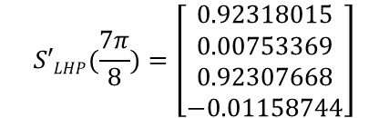
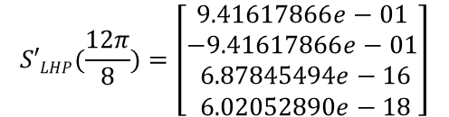
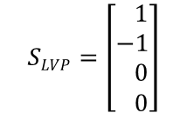
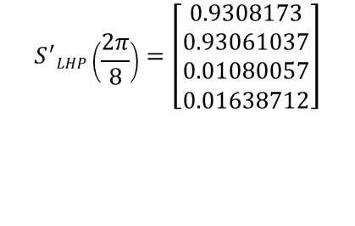
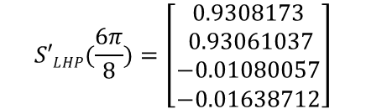
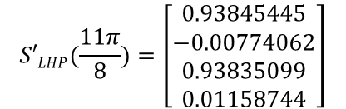
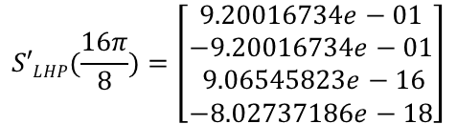
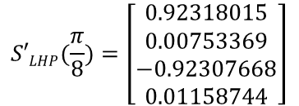
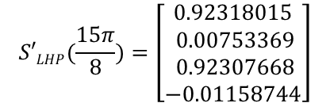
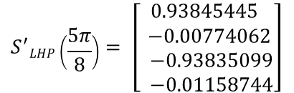
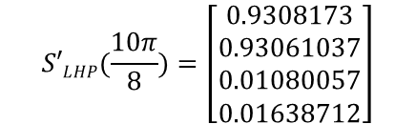
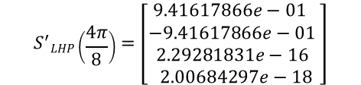
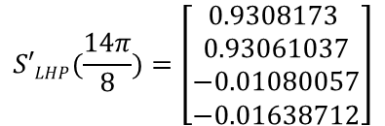
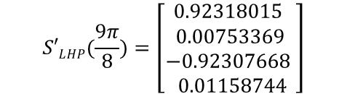
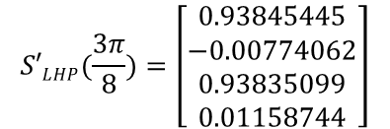
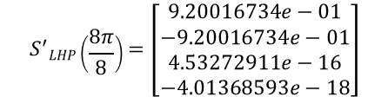
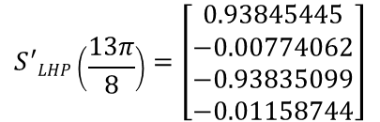
1. Passing LVP LIGHT THROUGH HWP made up of BBO CRYSTAL
$$SLVP=\left[\begin{matrix} 1 \\ −1 \\ 0 \\ 0\end{matrix}\right]$$
Input stokes vector
$$S′LHP(\frac{π}{8})=\left[\begin{aligned}0.92318015 \\ 0.00753369 \\ −0.92307668 \\ 0.01158744\end{aligned}\right]$$
$$S^{′}LHP\left(\frac{5π}{8}\right)= \left[\begin{aligned}0.93845445 \\ −0.00774062 \\ −0.93835099 \\ −0.01158744\end{aligned}\right]$$
$$S′LHP(\frac{9π}{8})=\left[\begin{aligned}0.92318015 \\ 0.00753369 \\ −0.92307668 \\ 0.01158744\end{aligned}\right]$$
$$S^{′}LHP\left(\frac{13π}{8}\right)=\left[\begin{aligned}0.93845445 \\ −0.00774062 \\ −0.93835099 \\ −0.01158744\end{aligned}\right]$$
$$S^{′}LHP\left(\frac{2π}{8}\right)=\left[\begin{aligned}0.9308173 \\ 0.93061037 \\ 0.01080057 \\ 0.01638712\end{aligned}\right]$$
$$S′LHP(\frac{6π}{8})=\left[\begin{aligned}0.9308173 \\ 0.93061037 \\ −0.01080057 \\ −0.01638712\end{aligned}\right]$$
$$S′LHP(\frac{10π}{8})=\left[\begin{aligned}0.9308173 \\ 0.93061037 \\ 0.01080057 \\ 0.01638712\end{aligned}\right]$$
$$S′LHP(\frac{14π}{8})=\left[\begin{aligned}0.9308173 \\ 0.93061037 \\ −0.01080057 \\ −0.01638712\end{aligned}\right]$$
$$S′LHP(\frac{7π}{8})=\left[\begin{aligned}0.92318015 \\ 0.00753369 \\ 0.92307668 \\ −0.01158744\end{aligned}\right]$$
$$S′LHP(\frac{11π}{8})=\left[\begin{aligned}0.93845445 \\ −0.00774062 \\ 0.93835099 \\ 0.01158744\end{aligned}\right]$$
$$S′LHP(\frac{15π}{8})=\left[\begin{aligned}0.92318015 \\ 0.00753369 \\ 0.92307668 \\ −0.01158744\end{aligned}\right]$$
$$S′LHP(\frac{3π}{8})=\left[\begin{aligned}0.93845445 \\ −0.00774062 \\ 0.93835099 \\ 0.01158744\end{aligned}\right]$$
$$S^{′}LHP\left(\frac{4π}{8}\right)=\left[\begin{aligned}9.41617866e−01 \\ −9.41617866e−01 \\ 2.29281831e−16 \\ 2.00684297e−18\end{aligned}\right]$$
$$S^{′}LHP\left(\frac{8π}{8}\right)=\left[\begin{aligned}9.20016734e−01 \\ −9.20016734e−01 \\ 4.53272911e−16 \\ −4.01368593e−18\end{aligned}\right]$$
$$S′LHP(\frac{12π}{8})=\left[\begin{aligned}9.41617866e−01 \\ −9.41617866e−01 \\ 6.87845494e−16 \\ 6.02052890e−18\end{aligned}\right]$$
$$S′LHP(\frac{16π}{8})=\left[\begin{aligned}9.20016734e−01 \\ −9.20016734e−01 \\ 9.06545823e−16 \\ −8.02737186e−18\end{aligned}\right]$$

Slide 12
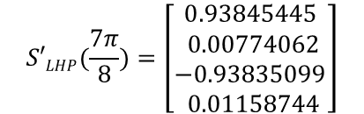
















2. Passing LHP LIGHT THROUGH HWP made up of BBO CRYSTAL
$$SLHP=\left[\begin{matrix} 1 \\ 1 \\ 0 \\ 0\end{matrix}\right]$$
Input stokes vector
$$S′LHP(\frac{π}{8})=\left[\begin{aligned}0.93845445 \\ 0.00774062 \\ 0.93835099 \\ −0.01158744\end{aligned}\right]$$
$$S^{′}LHP\left(\frac{5π}{8}\right)= \left[\begin{aligned}0.92318015 \\ −0.00753369 \\ 0.92307668 \\ 0.01158744\end{aligned}\right]$$
$$S′LHP(\frac{9π}{8})=\left[\begin{aligned}0.93845445 \\ 0.00774062 \\ 0.93835099 \\ −0.01158744\end{aligned}\right]$$
$$S^{′}LHP\left(\frac{13π}{8}\right)=\left[\begin{aligned}0.92318015 \\ −0.00753369 \\ 0.92307668 \\ 0.01158744\end{aligned}\right]$$
$$S^{′}LHP\left(\frac{2π}{8}\right)=\left[\begin{aligned}0.9308173 \\ −0.93061037 \\ 0.01080057 \\ −0.01638712\end{aligned}\right]$$
$$S′LHP(\frac{6π}{8})=\left[\begin{aligned}0.9308173 \\ −0.93061037 \\ −0.01080057 \\ 0.01638712\end{aligned}\right]$$
$$S′LHP(\frac{10π}{8})=\left[\begin{aligned}0.9308173 \\ −0.93061037 \\ 0.01080057 \\ −0.01638712\end{aligned}\right]$$
$$S′LHP(\frac{14π}{8})=\left[\begin{aligned}0.9308173 \\ −0.93061037 \\ −0.01080057 \\ 0.01638712\end{aligned}\right]$$
$$S′LHP(\frac{3π}{8})=\left[\begin{aligned}0.92318015 \\ −0.00753369 \\ −0.92307668 \\ −0.01158744\end{aligned}\right]$$
$$S′LHP(\frac{7π}{8})=\left[\begin{aligned}0.93845445 \\ 0.00774062 \\ −0.93835099 \\ 0.01158744\end{aligned}\right]$$
$$S′LHP(\frac{11π}{8})=\left[\begin{aligned}0.92318015 \\ −0.00753369 \\ −0.92307668 \\ −0.01158744\end{aligned}\right]$$
$$S′LHP(\frac{15π}{8})=\left[\begin{aligned}0.93845445 \\ 0.00774062 \\ −0.93835099 \\ 0.01158744\end{aligned}\right]$$
$$S^{′}LHP\left(\frac{4π}{8}\right)=\left[\begin{aligned}9.20016734e−01 \\ 9.20016734e−01 \\ −2.26636456e−16 \\ −2.00684297e−18\end{aligned}\right]$$
$$S^{′}LHP\left(\frac{8π}{8}\right)=\left[\begin{aligned}9.41617866e−01 \\ 9.41617866e−01 \\ −4.58563663e−16 \\ 4.01368593e−18\end{aligned}\right]$$
$$S′LHP(\frac{12π}{8})=\left[\begin{aligned}9.20016734e−01 \\ 9.20016734e−01 \\ −6.79909367e−16 \\ −6.02052890e−18\end{aligned}\right]$$
$$S′LHP(\frac{16π}{8})=\left[\begin{aligned}9.41617866e−01 \\ 9.41617866e−01 \\ −9.17127326e−16 \\ 8.02737186e−18\end{aligned}\right]$$

Slide 13





Calculation of the Mueller matrix of the Quartz and output stokes vector
Quartz as a Half wave plate for wavelength(λ)=632nm
n_{o} = 1.5445;
n_{e} = 1.55338;
thickness(t) = 34611.17nm
S
S’
$$MHWP=\left[\begin{matrix}0.9056156 & −0.0013996 & 0 & 0 \\ −0.00139968 & 0.9056156 & 0 & 0 \\ 0 & 0 & −0.90560962 & 0.00297985 \\ 0 & 0 & −0.00297985 & −0.9056096\end{matrix}\right]$$
$$SLHP=\left[\begin{matrix}1 \\ 1 \\ 0 \\ 0\end{matrix}\right]$$
$$S′LHP=\left[\begin{matrix}0.90421592 \\ 0.90421592 \\ 0 \\ 0\end{matrix}\right]$$
$$SRCP=\left[\begin{matrix}1 \\ 0 \\ 0 \\ 1\end{matrix}\right]$$
$$S′LCP=\left[\begin{matrix}0.90421592 \\ 0 \\ 0 \\ −0.90560962\end{matrix}\right]$$

Slide 14



Calculation of the Mueller matrix of the Calcite and output stokes vector
Calcite as a Half wave plate for wavelength(λ)=590nm
n_{o} = 1.658;
n_{e} = 1.486;
thickness(t) = 1715.116nm
S
S’
$$MHWP=\left[\begin{matrix}0.84985378 & −0.01720098 & 0 & 0 \\ −0.01720098 & 0.84985378 & 0 & 0 \\ 0 & 0 & −0.8491283 & 0.01293133 \\ 0 & 0 & −0.01293133 & −0.8491283\end{matrix}\right]$$
$$SLHP=\left[\begin{matrix}1 \\ 1 \\ 0 \\ 0\end{matrix}\right]$$
$$S′LHP=\left[\begin{matrix}0.88249374 \\ 0.88249374 \\ 0 \\ 0\end{matrix}\right]$$
$$SRCP=\left[\begin{matrix}1 \\ 0 \\ 0 \\ 1\end{matrix}\right]$$
$$S′RCP=\left[\begin{matrix}0.84985378 \\ 0.03263996 \\ 0.01293133 \\ −0.8491283\end{matrix}\right]$$

Slide 15



Calculation of the Mueller matrix of the BBO and output stokes vector
BBO as a Half wave plate for wavelength(λ)=632.8nm
n_{o} = 1.6672;
n_{e} = 1.5496;
thickness(t) = 2690.476nm
S
S’
$$MHWP=\left[\begin{matrix}0.9308173 & 0.0108005 & 0 & 0 \\ 0.01080057 & 0.9308173 & 0 & 0 \\ 0 & 0 & −0.93061037 & −0.01638712 \\ 0 & 0 & 0.01638712 & −0.93061037\end{matrix}\right]$$
$$SLHP=\left[\begin{matrix}1 \\ 1 \\ 0 \\ 0\end{matrix}\right]$$
$$S′LHP=\left[\begin{matrix}0.94161787 \\ 0.94161787 \\ 0 \\ 0\end{matrix}\right]$$
$$SRCP=\left[\begin{matrix}1 \\ 0 \\ 0 \\ 1\end{matrix}\right]$$
$$S′RlCP=\left[\begin{matrix}0.9308173 \\ 0.01080057 \\ −0.01638712 \\ −0.93061037\end{matrix}\right]$$

Slide 16




Calculation of the Mueller matrix of the YVO₄ and output stokes vector
YVO₄ as a Half wave plate for wavelength(λ)=632.8nm
n_{o} = 1.9929;
n_{e} = 2.2154;
thickness(t) = 1422.022nm
S
S’
$$MHWP=\left[\begin{matrix}0.99120803 & −0.00129838 & 0 & 0 \\ −0.00129838 & 0.99120803 & 0 & 0 \\ 0 & 0 & −0.99118213 & −0.00704824 \\ 0 & 0 & 0.00704824 & −0.99118213\end{matrix}\right]$$
$$SLHP=\left[\begin{matrix}1 \\ 1 \\ 0 \\ 0\end{matrix}\right]$$
$$S′LHP=\left[\begin{matrix}0.98990965 \\ 0.98990965 \\ 0 \\ 0\end{matrix}\right]$$
$$SRCP=\left[\begin{matrix}1 \\ 0 \\ 0 \\ 1\end{matrix}\right]$$
$$S′RCP=\left[\begin{matrix}0.99120803 \\ −0.00129838 \\ 0.00704824 \\ 0.99118213\end{matrix}\right]$$

Slide 17



Calculation of the Mueller matrix of the Quartz and output stokes vector
Quartz as a Quarter wave plate for wavelength(λ)=632nm
n_{o} = 1.5445;
n_{e} = 1.55338;
thickness(t) = 17,305.585nm
S
S’
$$MHWP=\left[\begin{matrix}0.9119164 & 0.05784294 & 0 & 0 \\ 0.05784294 & 0.91191643 & 0 & 0 \\ 0 & 0 & −0.06133062 & −0.90801119 \\ 0 & 0 & 0.90801119 & −0.06133062\end{matrix}\right]$$
$$SLHP=\left[\begin{matrix}1 \\ 1 \\ 0 \\ 0\end{matrix}\right]$$
$$S′LHP=\left[\begin{matrix}0.96975937 \\ 0.96975937 \\ 0 \\ 0\end{matrix}\right]$$
$$SRCP=\left[\begin{matrix}1 \\ 0 \\ 0 \\ 1\end{matrix}\right]$$
$$S′(−450LP)=\left[\begin{matrix}0.91191643 \\ 0.05784294 \\ −0.90801119 \\ −0.06133062\end{matrix}\right]$$

Slide 18



Calculation of the Mueller matrix of the YVO₄ and output stokes vector
YVO₄ as a Quarter wave plate for wavelength(λ)=632.8nm
n_{o} = 1.9929;
n_{e} = 2.2154;
thickness(t) = 711.011nm
S
S’
$$MHWP=\left[\begin{matrix}0.82048267 & 0.17696753 & 0 & 0 \\ 0.17696753 & 0.82048267 & 0 & 0 \\ 0 & 0 & 0.0236888 & −0.8008203 \\ 0 & 0 & 0.8008203 & 0.0236888\end{matrix}\right]$$
$$SLHP=\left[\begin{matrix}1 \\ 1 \\ 0 \\ 0\end{matrix}\right]$$
$$S′LHP=\left[\begin{matrix}0.99745021 \\ 0.99745021 \\ 0 \\ 0\end{matrix}\right]$$
$$SRCP=\left[\begin{matrix}1 \\ 0 \\ 0 \\ 1\end{matrix}\right]$$
$$S′(−450LP)= =\left[\begin{matrix}0.82048267 \\ 0.17696753 \\ −0.8008203 \\ 0.0236888\end{matrix}\right]$$

Slide 19



Calculation of the Mueller matrix of the BBO and output stokes vector
BBO as a Quarter wave plate for wavelength(λ)=632.8nm
n_{o} = 1.6672;
n_{e} = 1.5496;
thickness(t) = 1345.23nm
S
S’
$$MHWP=\left[\begin{matrix}0.90946157 & −0.06737505 & 0 & 0 \\ −0.06737505 & 0.90946157 & 0 & 0 \\ 0 & 0 & −0.05632399 & 0.90521188 \\ 0 & 0 & −0.90521188 & −0.05632399\end{matrix}\right]$$
$$SLHP=\left[\begin{matrix}1 \\ 1 \\ 0 \\ 0\end{matrix}\right]$$
$$S′LHP=\left[\begin{matrix}0.84208652 \\ 0.84208652 \\ 0 \\ 0\end{matrix}\right]$$
$$SRCP=\left[\begin{matrix}1 \\ 0 \\ 0 \\ 1\end{matrix}\right]$$
$$S′(450LP)= =\left[\begin{matrix}0.90946157 \\ −0.06737505 \\ 0.90521188 \\ −0.05632399\end{matrix}\right]$$

Slide 20



Calculation of the Mueller matrix of the Calcite and output stokes vector
Calcite as a Quarter wave plate for wavelength(λ)=590nm
n_{o} = 1.658;
n_{e} = 1.486;
thickness(t) = 857.55nm
S
S’
$$MHWP=\left[\begin{matrix}0.91082659 & −0.01720098 & 0 & 0 \\ −0.01720098 & 0.91082659 & 0 & 0 \\ 0 & 0 & 0.08105534 & 0.90704974 \\ 0 & 0 & −0.90704974 & 0.08105534\end{matrix}\right]$$
$$SLHP=\left[\begin{matrix}1 \\ 1 \\ 0 \\ 0\end{matrix}\right]$$
$$S′LHP=\left[\begin{matrix}0.89362561 \\ 0.89362561 \\ 0 \\ 0\end{matrix}\right]$$
$$SRCP=\left[\begin{matrix}1 \\ 0 \\ 0 \\ 1\end{matrix}\right]$$
$$S′(450LP)==\left[\begin{matrix}0.91082659 \\ −0.01720098 \\ 0.90704974 \\ 0.08105534\end{matrix}\right]$$

Slide 21


Dual Rotating retarder polarimeter
This is the experimental way to find the Mueller matrix of the sample.
It consist of PSA and PSG which is placed before and after the sample.
PSA always consist of QWP and LP, while PSG depends upon illuminating source polarization state.
Sofia Obando-Vasquez, Ana Doblas, Carlos Trujillo; Apparatus and method to recover the Mueller matrix in bright-field microscopy. American Journal of Physics 1 September 2022; 90 (9): 702–714. https://doi.org/10.1119/5.0081673

Slide 22
WORKING PROCEDURE: (1) Apparatus setup
A sample is imaged using an infinity corrected microscope objective lens which produces the image of the sample at infinity.
To produce the real sample of the image Tube lens is used.
Microscope image plane is located at the back the focal plane of the TL lens.
The CCD is also located to the back focal plane of the TL.
PSG and PSA is place before the sample and after the TL.
The PSA is always composed of the QWP followed by the Linear polarizer.
The PSG system depend upon the polarization state of the illuminating Source.
Randomly PL | Linear polarizer | QWP
Linearly PL | HWP | QWP
EPL | Linear Polarizer + HWP | QWP
Randomly PL | Linear polarizer | QWP
Linearly PL | HWP | QWP
EPL | Linear Polarizer + HWP | QWP
We can use the depolarizer also instead of the Linear polarizer if we are using EPL, because it convert the EPL into the randomly polarized light.

Slide 23




Relation between Mueller matrix element and different linear combination of intensities
[m₀₀ = (HH + HV + VH + VV)]; [m₀₁ = (HH + HV –VH –VV)]; [m₀₂ = (PH + PV – MH – MV)]; [m₀₃ = (RH – RV – LH - LV)]
[m₁₀= (HH – HV + VH – VV)]; [m₁₁= (HH – HV – VH + VV)]; [m₁₂= (PH – PV – MH + MV)]; [m₁₃ = (RH – RV – LH + LV)]
[m₂₀= (HP – HM + VP - VM)]; [m₂₁= (HP – HM – VP + VM)]; [m₂₂= (PP – PM – MP + MM)]; [m₂₃ = (RP – RM – LP + LM)]
[m₃₀ = (HR – HL + VR - VL)]; [m₃₁ = (HR – HL –VR + VL)]; [m₃₂ = (PR – PL – MR + ML) ]; [m₃₃ = (LL – RL – LR + RR)]
M_{sample} =
$D= \frac{\sqrt{\left(moo\right)2+\left(mo3\right)2+\left(mo2\right)2 }}{moo}$
$P= \frac{\sqrt{\left(m10\right)2+\left(m20\right)2+\left(m30\right)2 }}{moo}$
∆ = 1- $\frac{\sqrt{−\left(moo\right)2+\left(\sum_{i=0}^{3}{(mii}\right)2 })}{moo}$
Sofia Obando-Vasquez, Ana Doblas, Carlos Trujillo; Apparatus and method to recover the Mueller matrix in bright-field microscopy. American Journal of Physics 1 September 2022; 90 (9): 702–714. https://doi.org/10.1119/5.0081673

Slide 24

(3) Recording of the images
Once the system is aligned the images are taken with following configuration of the PSG and PSA
In this method,
polarization states in both PSG and PSA systems must be generated: vertical polarization, i.e., 90º (V), horizontal polarization, i.e., 0º (H), linear polarization at 45º (P), linear polarization at 45º (M), righthanded circular polarization (R), and left-handed circular polarization (L).
Refrences: Sofia Obando-Vasquez, Ana Doblas, Carlos Trujillo; Apparatus and method to recover the Mueller matrix in bright-field microscopy. American Journal of Physics 1 September 2022; 90 (9): 702–714. https://doi.org/10.1119/5.0081673

Slide 25
Conclusion
Mueller matrix of any sample can be generate for biological sample using the dual rotating polarimeter.
We can generate any phase difference using the SBC by simple calculation of thickness and wavelength.
We can get mueller matrix of any arbitrary placed optic axis in retarded plates.
We can design our own SBC according to the available light source and type of crystal.
We can get any polarizing properties if we knew the mueller matrix of the sample.

Slide 26

Acknowledgement
DR. V. Narayanan
I would like to express my special thanks to project supervisor Dr. V. Narayanan and Ph.D scholars Tomis and Ravikant for their able guidance and support in continuing this project. I would also like to thank all my lab members to helped me in this project and motivating me to continuing this project
Thank you

Slide 27
Refrences
Hagen, Nathan & Dereniak, Eustace. (2007). Snapshot Mueller matrix spectropolarimetry. 6682. 10.1117/12.736575.
Bhattacharyya, Kaustav & Serrano Garcia, David & Otani, Yukitoshi. (2017). Accuracy enhancement of dual rotating mueller matrix imaging polarimeter by diattenuation and retardance error calibration approach. Optics Communications. 392. 48-53. 10.1016/j.optcom.2017.01.029.
Letnes, Paul & Maradudin, Alexei & Nordam, T. & Simonsen, Ingve. (2011). Calculation of the Mueller matrix for scattering of light from two-dimensional rough surfaces. Phys. Rev. A. 86. 10.1103/PhysRevA.86.031803.
Arteaga, Oriol & Baldrís, Marta & Anto, Joan & Canillas, Adolf & Pascual, Esther & Bertran, Enric. (2014). Mueller matrix microscope with a dual continuous rotating compensator setup and digital demodulation. Applied optics. 53. 2236-2245. 10.1364/AO.53.002236.
Sofia Obando-Vasquez, Ana Doblas, Carlos Trujillo; Apparatus and method to recover the Mueller matrix in bright-field microscopy. American Journal of Physics 1 September 2022; 90 (9): 702–714.
Zhang, Wenjing & Zhang, Zhiwei. (2016). Heterodyne interferometry method for calibration of a Soleil–Babinet compensator. Applied Optics. 55. 4227. 10.1364/AO.55.004227.
Thomas Essinger-Hileman, "Transfer matrix for treating stratified media including birefringent crystals," Appl. Opt. 52, 212-218 (2013)

